Slide 1








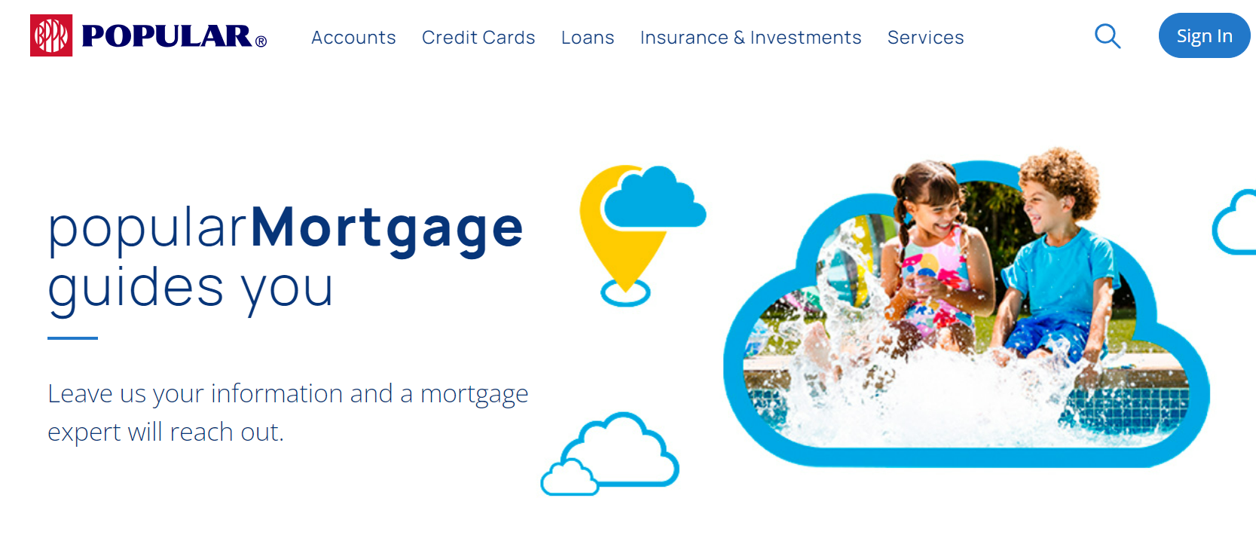









a tu ritmo
Thank
you!
Salesforce user downloads a report prioritized on the step they are in.
Lead is automatically created in salesforce with all the fields submitted in the form
Customer submits form and the screen will show a thank you and we’ll call you message .
Customer goes to Popular Mortgage webpage looking for information.
Purchase or Refinance?
Refinance
Customer is thinking of purchasing a house or refinancing his property
Customer wants to know his credit limit and the different loans he can apply to (“prequalification letter”)
Completes simple form
Customer asks a Popular Mortgage sales agent.
For some reason, the agent can’t complete the prequalification letter and provides a unique sales agent link so the customer can complete it later.
Purchase
Popular Mortgage employee updates weekly offers table and reviews the DTI parameters and sales agent tables and updates it on Salesforce.
*If customer states in the form he is not a veteran the VA option should not show
Contact
us!
Salesforce user downloads a report that aggregates leads by email phone number and email
Customer will see a contact us message in the screen and lead is generated in Salesforce
Customer receives email with prequalification letter showing the pricing for the 3 products*. If the form was completed thru the unique vendor link, email closure should include the sales agent #.
Letter must show unique ID.
No
Thank
you!
Customer qualifies for 1 of the 3 products?
Yes
Salesforce calculates the credit limit and verifies if the customer qualifies for 1 of the 3 products
Customer submits form and the screen will show a thank you message.
Completes a more extensive form. Also, will need to fill in additional information if the loan will be with a co-applicant
Customer calls in to discuss prequalification letter and agent retrieves the lead thru the letter unique ID
Lead is automatically created in salesforce with all the fields submitted in the form. The letter must be attached to the lead.

